Slide 1
Divide and Conquer The Maximum SubArray
Tanjina Helaly
CSI 227: Algorithms, Fall 2017
Department of Computer Science and Engineering
United International University

Slide 2
Divide and Conquer
Divide:
Divide the problem into number of sub-problems that are smaller instances of the same problem.
Conquer
Conquer the sub-problems by solving them recursively. If the sub-problem sizes are small enough, solve them in a straight forwards manner.
Combine
Combine the solutions to the sub-problems into the solution for the original problem.

Slide 3
The Maximum Subarray
The maximum sub-array problem is the task of finding the contiguous sub-array within a one-dimensional array of numbers which has the largest sum.
Input:
an array a[1...n] of (positive/negative) numbers.
Output:
Indices i and j such that A[i...j] has the greatest sum of any nonempty, contiguous subarray of a, along with the sum of the values in a[i...j].
Note:
Maximum subarray might not be unique, though its value is, so we speak of a maximum subarray, rather than the maximum subarray.

Slide 4
The Maximum Subarray - example
Example 1
Example 2
Day | 0 1 2 3 4
Price | 10 11 7 10 6
Change a[…] | 1 -4 3 -4
Max Sub Array : a[3] = 3
Day | 0 1 2 3 4 5 6 7
Price | 10 11 7 10 9 12 15 13
Change a[…] | 1 -4 3 -1 3 3 -2
Max Sub Array : a[3…6] = 8

Slide 5
Maximum Subarray -Brute Force algorithm
Calculate the sum of subarray of size 1, then 2, then 3 and so on. Find the subarray that gives the max sum.
Algorithm
for each subarray{
sum = sum of all elements of that subarray.
if(sum>ans)
ans = sum
}

Slide 6
Maximum Subarray -Brute Force algorithm
Algorithm
subArray(a)
For i = subArraySize = 1 to length
sum = 0;
For start_index = 1 to length
if(start_index +subArraySize> length)
break;
For j = start_index to (start_index +subArraySize)
sum += a[i+subArraySize-1];
if(sum> max)
max = sum;
return max
Time Complexity - (n³)

Slide 7
Maximum Subarray –Improvised Brute Force algorithm
Algorithm
subArray(a)
For i = 1 to length
sum = 0;
For subArraySize = 1 to length
if(i+subArraySize> length)
break;
sum += a[i+subArraySize-1];
if(sum> max)
max = sum;
return max
Time Complexity - (n²)

Slide 8
Maximum Subarray–divide & conquer
3 | -1 | 6 | -2
3 | -1
6 | -2
MSS =3
MSS =6
Divide the array to 2 subarrays.
Find the MSS of 2 subarrays.
Also need the find the MSS that crosses the 2 subarrays.
Combine the Solution.

Slide 9
Maximum Subarray–divide & conquer
MSS =8
3 | -1 | 6 | -2
3 | -1
6 | -2
MSS =3
MSS =6
Combine the solution
MSS of the whole array could be
Entirely in left subarray, or
Entirely in right subarray, or
crossing the midpoint, some part lie in left subarray and the remaining in right

Slide 10
Maximum Subarray–divide & conquer
MSS =8
3 | -1 | 6 | -2
3 | -1
6 | -2
MSS =3
MSS =6
Combine the Solution.
MSS of the whole array would be the biggest MSS among three(left, right an cross)

Slide 11
Maximum Subarray–divide & conquer
FindMaxSubArray(int[] A, low, high){
if(high == low)
return (low, high, A[low]);
else{
mid = (low+high)/2;
(leftlow, lefthigh, leftsum) = FindMaxSubArray(A, low, mid);
(rightlow, righthigh, rightsum) = FindMaxSubArray(A, mid+1, high);
(crosslow, crosshigh, crosssum) = FindCrossMaxSubArray(A, low, mid, high);
if(leftsum>rightsum && leftum>crosssum)
return (leftlow, lefthigh, leftsum);
else if(rightsum>leftsum && rightsum>crosssum)
return (rightlow, righthigh, rightsum);
}
return (crosslow, crosshigh, crosssum);
}
}

Slide 12
Crossing subarray
FindCrossMaxSubArray(A, low, mid, high)
leftSum = -α
sum=0;
For i= mid down to low
sum += A[i];
if(sum>leftSum){
leftSum = sum;
maxLeft = i;
rightSum = -α
sum=0;
For i= mid+1 to high
sum += a[i];
if(sum>rightSum){
rightSum = sum;
maxRight = i;
return (maxLeft, maxRight, leftSum+rightSum);

Slide 13
Time Complexity
T(n/2) for each subarray of size n/
(n) for the cross array MSS
(1) for the comparing the 3 MSS(left, right and cross)
This is similar to merge sort
T(n) =θ(n log n)

Slide 14
Kadane’s Algorithm – Original version -(n)
Scan/iterate through the list once.
Time Complexity: (n)
Drawback: Original version only works if the array has at least 1 positive element.
Algorithm
findMaxSubArraySum(int[] a)
max_so_far = 0, max_ending_here = 0;
For i = 1 to length
max_ending_here += a[i];
if(max_ending_here<0])
max_ending_here = 0;
if(max_ending_here>max_so_far)
max_so_far = max_ending_here;
return max_so_far;

Slide 15
Kadane’s Algorithm – Modified version(n)
Works for any array- for both positive and/or negative elements.
Algorithm
findMaxSubArraySum(int[] a)
max_so_far = a[1], max_ending_here = a[1];
// To find start and end index, need the following variables.
// If you want you can also return these value
s_index=0,e_index=0, s_index_ending_here =0;
For i = 2 to length
max_ending_here += a[i];
if(max_ending_here<a[i])
max_ending_here = a[i];
// start index after getting a negative sum
s_index_ending_here = i;
if(max_ending_here>max_so_far)
max_so_far = max_ending_here;
e_index = i;
s_index = s_index_ending_here;
return max_so_far;

Slide 16
Application/example

Slide 17
Volatile Chemical Corporation – A Stock company.
Suppose that you been offered the opportunity to invest in the Volatile Chemical Corporation.
You are allowed to buy one unit of stock only one time and then sell it at a later date, buying and selling after the close of trading for the day.
To compensate for this restriction, you are allowed to learn what the price of the stock will be in the future.

Slide 18
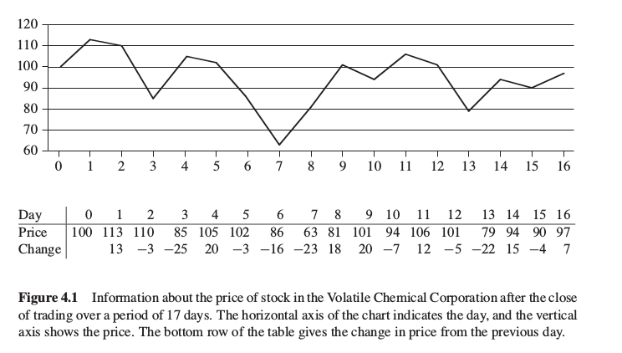
Volatile Chemical Corporation – A Stock company.

Slide 19
The stock problem
Your target is to maximize profit
Find the lowest point/price?
Choose the highest price?
The difference should give you maximum profit.
But what if the highest comes before the lowest price.

Slide 20
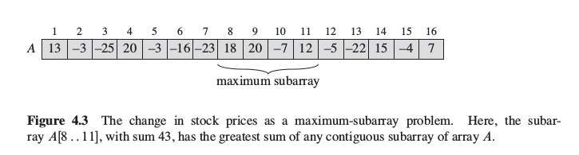
Try Maximum SubArray
Brute force
Try all pair
will give you θ(n³) or θ(n²) time complexity

Slide 21
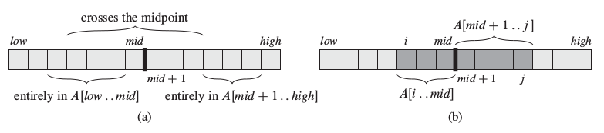
Try Maximum SubArray – divide & conquer
We want to find a maximum subarray of A[low : high]
Any contiguous subarray A[i : j ] must lie:
Entirely in the subarray A[low : mid], so that
low ≤ i ≤ j ≤ mid
entirely in the subarray A[mid + 1 : high], so that
mid ≤ i ≤ j ≤ high, or
crossing the midpoint, so that low ≤ i ≤ mid ≤ j ≤ high

Slide 22
Try these
What does this function return if all numbers are positive?
What does this function return if all numbers are negative?

Slide 23
Reference
Chapter 4.1 (Cormen)

